Slide 1
ANALYSIS OF NOVEL CORONAVIRUS
Day level information on covid-19 cases
PRESENTATION LINK
SURAJ S. BHUTE

Slide 2
CONTENTS
01. Introduction
Analysis based on parameters
02. Global Cases
04. State-Wise Cases
Total Number of Confirmed Cases
Total Number of Recovered Cases
Total Number of Deaths Cases
Confirmed Cases Time Series of Top Five Regions
Recovered Cases Time Series of Top Five Regions
Death Cases Time Series of Top Five Regions
Confirmed Cases Time Series
Recovered Cases Time Series
05. [MH State]Districts Wise Cases
Confirmed Cases Time Series
Recovered Cases Time Series
03. India Cases
06. Conclusion
Confirmed Cases Time Series
Recovered Cases Time Series
Death Cases Time Serie
Confirmed Cases Time Series of Top Three States
Recovered Cases Time Series of Top Three States

Slide 3
01
Introduction
Inspiration
Your data will be in front of the world's largest data science community.
What questions do you want to see answered?
Changes in number of affected cases over time
Change in cases over time at country level
Latest number of affected cases
Dataset Link
https://www.kaggle.com/ambilidn/covid19-dataset-india?select=State-wise+statistics.xlsx
https://github.com/CSSEGISandData/COVID-19
https://api.covid19india.org/

Slide 4
What is Coronavirus[covid-19] ?
Respiratory illness
Coronavirus can be spread from person to person.
Coronavirus that emerged in china in December 2019.
Common symptoms
Cough, Fever, shortness of breath, Body aches and Runny Nose

Slide 5
Global Cases
02

Slide 6
Objective
Total Number of Confirmed Cases
5329606426
TOP 3 Region
US: 1194185608
INDIA: 776274747
BRAZIL: 672625828

Slide 7
Objective
Total Number of Recovered Cases
3373587830
TOP 3 Region
US: 422291826
INDIA: 657934227
BRAZIL: 560168520

Slide 8
Objective
Total Number of Death Cases
172065014
TOP 3 Region
US: 37179442
INDIA: 12702847
BRAZIL: 21369310

Slide 9
Confirmed Cases Time Series of Top Five Regions
Objective
Top Five Regions Throughout the World
1.US
2.Brazil
3.Russia
4.India
5.Spain

Slide 10
Recovered Cases Time Series of Top Five Regions
Objective
Top Five Regions Throughout the World
1.US
2.Brazil
3.Russia
4.India
5.Peru

Slide 11
Death Cases Time Series of Top Five Regions
Objective
Top Five Regions Throughout the World
1.US
2.Brazil
3.Mexico
4.United Kingdom
5.India

Slide 12
India Cases
03

Slide 13
Objective
Confirmed Cases Time Series
Recovered Cases Time Series
Although confirmed case were with huge number
but looking towards chart Recovered cases
are about 50-70%

Slide 14
Objective
Death Cases Time Series
Recovered Cases Time Series
Although confirmed case were with huge number
but looking towards chart Recovered cases
are about 50-70% but Remaing 20% were the Death cases

Slide 15
Objective
Confirmed Cases Time Series of Top Three States
TOP 3 STATES
1.Maharashtra
2.Andhra Pradesh
3.Tamil Nadu

Slide 16
Objective
Recovered Cases Time Series of Top Three State
TOP 3 STATES
1.Maharashtra
2.Andhra Pradesh
3.Tamil Nadu
Although confirmed case were with huge number
but looking towards chart Recovered cases
are about 90-95%

Slide 17
State-Wise Cases
03

Slide 18
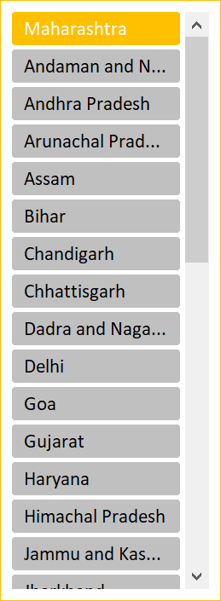
Confirmed Cases & Recovered Cases Time Series of last 3 Months
Objective
Although confirmed case were with huge number
but looking towards chart Recovered cases
are about 50-70%

Slide 19
04
[MH State]Districts Wise Cases

Slide 20
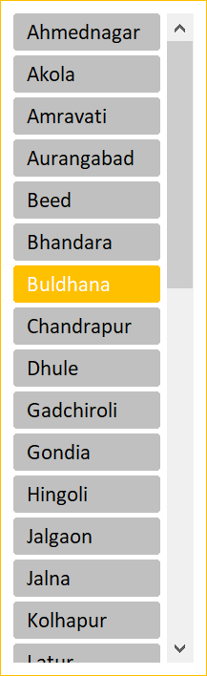
Objective
Confirmed Cases Time Series of of last 4 months
Although confirmed case were with huge number in November
but looking towards chart Recovered cases
are about 90-95%

Slide 21
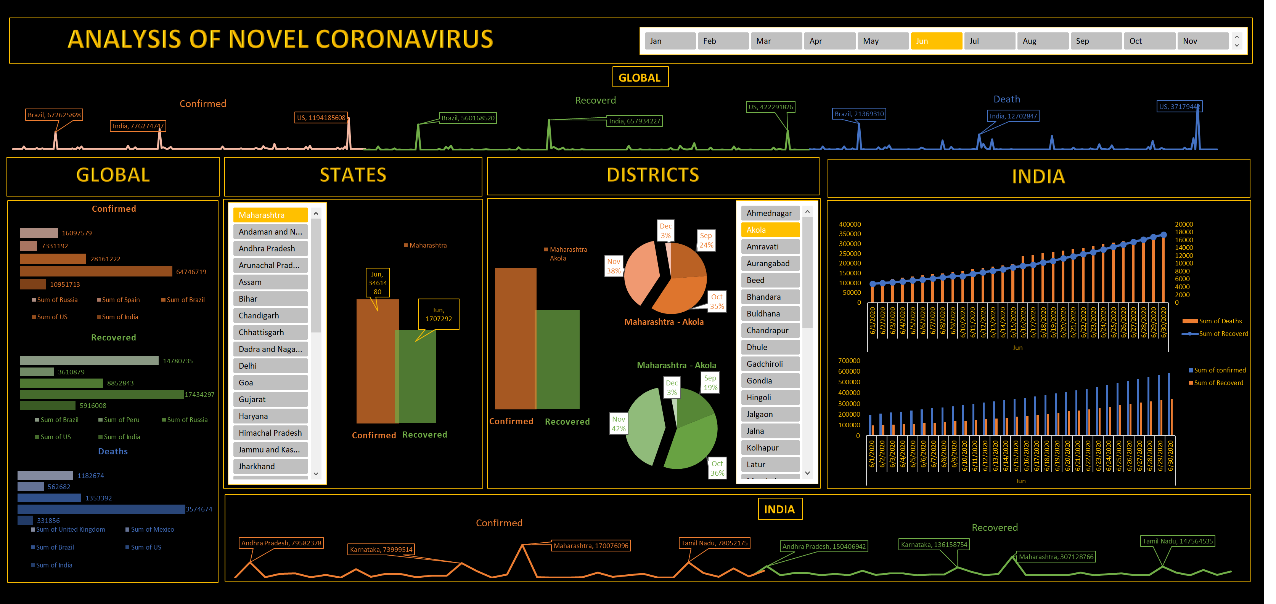
DASHBOARD

Slide 22
06
Conclusion

Slide 23
THANK YOU
Presentation Link:
https://drive.google.com/file/d/1og4vtjTEYHxGQpkKY9rIMTDVUtxmvx8n/view?usp=sharing
https://drive.google.com/file/d/1yCnT5VtD7vlvxYFYXfZOK_6J_FSrVsY6/view?usp=sharing

